Slide 1

NGO-ISAC
Endpoint Security Advice
Email ian@ngoisac.org | +1.202.230.7651
https://www.ngoisac.org/ membership@ngoisac.org

Slide 2
Definitions
Endpoint – A device or computer or system including virtual systems.
EDR – Endpoint detection and response
SIEM – Security information and event management
Alert Fatigue – when systems generate so many alerts you pay attention to none
False positive
False Negative
Toil – manual, repetitive, automatable, work with little enduring value that scales linearly with your organization

Slide 3
Endpoint Security (mature)
VPN
transport protection
place shifting via network address translation
requires engineering investment

Slide 4
Endpoint Security (mature)
Firewall
threats on the wire
protocol exploits
requires engineering investment

Slide 5
Endpoint Security (mature)
Anti-Virus
Protects from known threats
Big Virus (™) loves known AV databases
and knows how to side step it

Slide 6
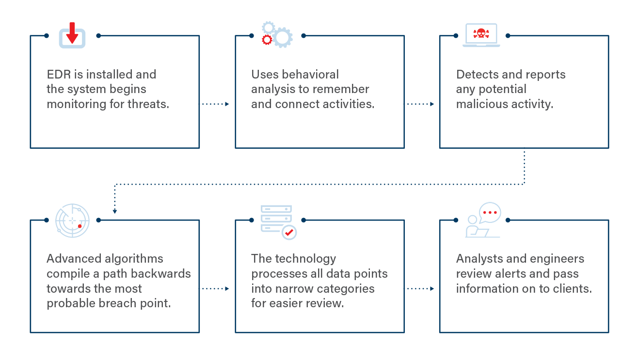
How do EDRs operate?
https://www.openedr.com/blog/how-does-edr-work/

Slide 7

EDR benefits
Evolved from firewalls / Antivirus
EDR monitors compromises
signature database
Subscription update
infer 'intent'
prevent malicious software
Protect from some network intrusion
active defenses
fleet wide visibility
Dashboard
Notes:
https://commons.wikimedia.org/wiki/File:Iceberg.jpg

Slide 8
EDR limitations
protects vs. active attacks
cannot anticipate future
false positives
signature based
Not intent based
attackers with credentials
$$$ + $$$$ + $$$ + …
license
data egress/storage
Notes:
https://commons.wikimedia.org/wiki/File:Iceberg.jpg

Slide 9
List of EDR vendors
Crowdstrike
Sentinel One
Microsoft Defender
Sophos
Carbon Black
Cisco Secure Endpoint
Symantec Endpoint Protection
ESET
Datto
Huntress
TrendMicro
Trellix Endpoint Security
FortiEDR
WatchGuard
Open EDR

Slide 10
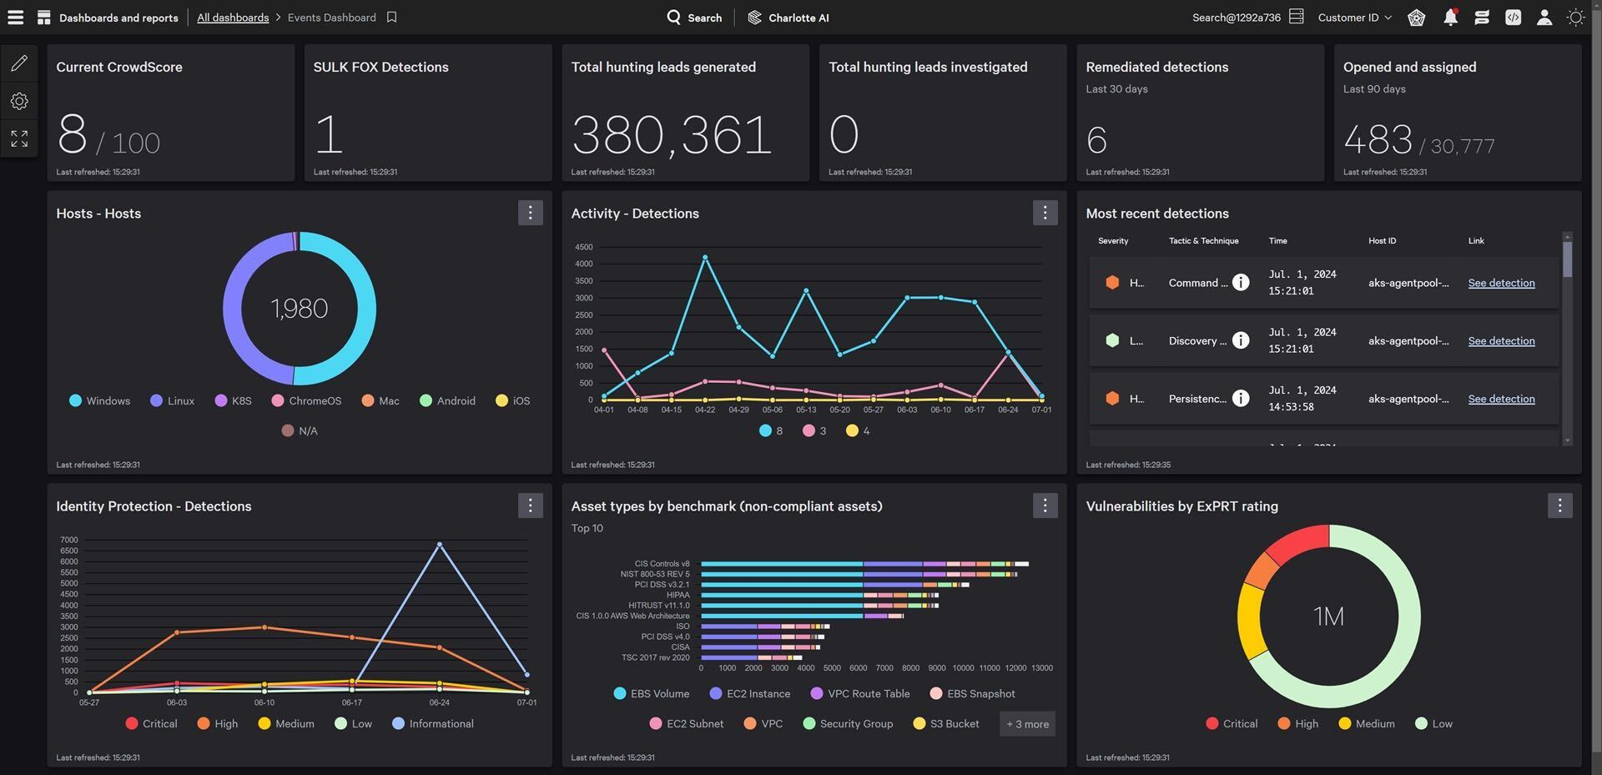
Crowdstrike

Slide 11
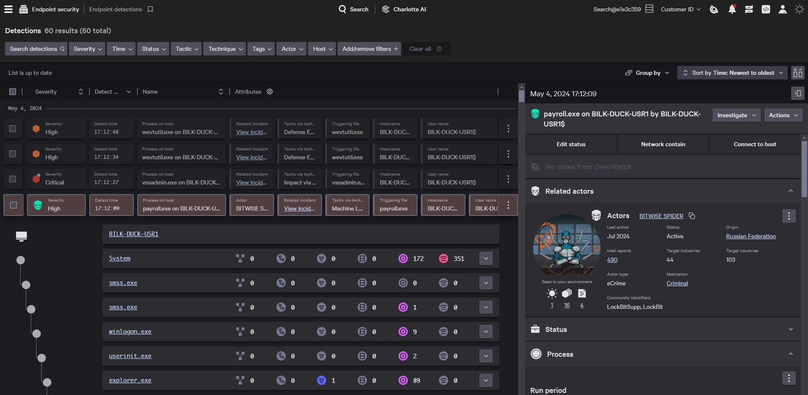
Crowdstrike

Slide 12
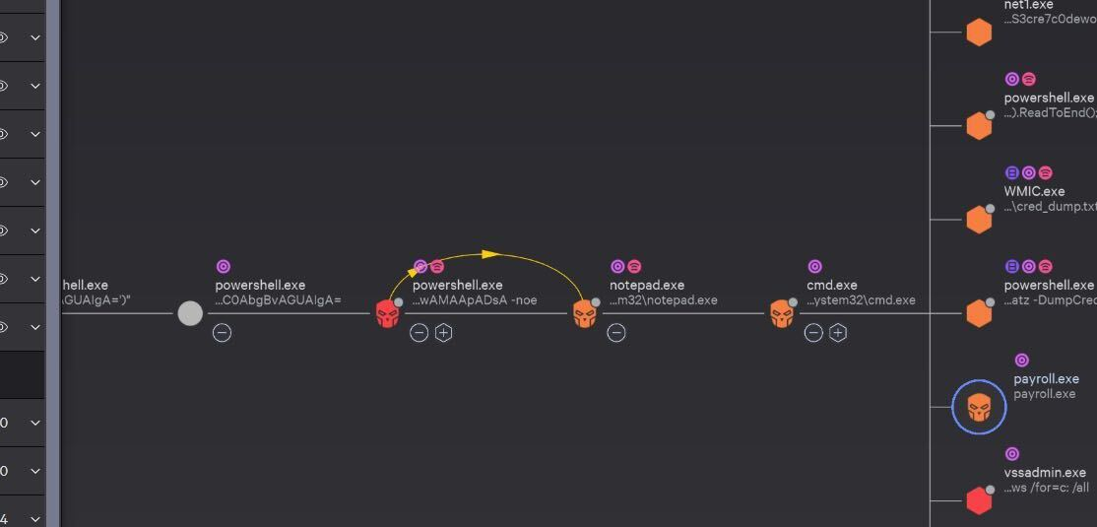
Crowdstrike

Slide 13
Managed Security Service Provider (MSSP)
EDR output is time consuming
false positive/false negative
Hiring a team
cost effective way to manage EDR. *

Slide 14
alert fatigue, S/N ratio
You have a thousand yapping puppies, none get any attention
EDRs generate multitudes of noisy alerts until an operator grooms the alerts into something actionable. This is alert fatigue.
Google SRE elimination of toil
Work with no enduring value
Google SRE alerts
Service Level Objective metric error rate alert
Google SRE practical alerting on time series data
Borgmon's language for alerting

Slide 15
EDR alert cycle
Install EDR
1
There is a cycle to EDR alerts
Not all of it is or can be automated. Context about where a user is and what they are doing is critical to be able
4
2
Incident Response Actions
Alert is triggered
3
Analyze and groom alerts

Slide 16

What’s not covered by EDRs (yet?)
Phones / Mobile Devices
Mobile Device Manager (MDM)
Jamf, Kandji, Apple Business Services, airwatch
But maybe better than an MDM
iVerify - continuous user coaching

Slide 17

What can you do without an EDR?
Be better:
configuration management
Reduce attack surface
remove apps
Advanced protection program
Lockdown mode
update management strategy
Problems:
No visibility to attacks
Attacks won’t work silently
Ludwig Mies van der Rohe

Slide 18
[ Questions ? ]
Notes:
Be ready for: Constellation, Membership dues

Slide 19
Thank You
[ Author / job title ]
Email address @ngoisac.org | +1.[ telephone]
https://www.ngoisac.org/
membership@ngoisac.org

Slide 20














Our Cyber Security Industry Partners
~ 25 Partners

